Slide 1

Generating Cyber Forensic Data
Randall Dickinson and Sasha Petushkov

Slide 2


Problem Statement
Modern computers are vulnerable to attacks
System Monitor (Sysmon) logs can help detect abnormal activity
Data may be hard to procure and use for training
Need a way to generate data to build larger datasets
Generating fake data may allow for classification tasks

Slide 3


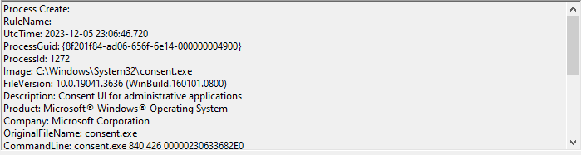
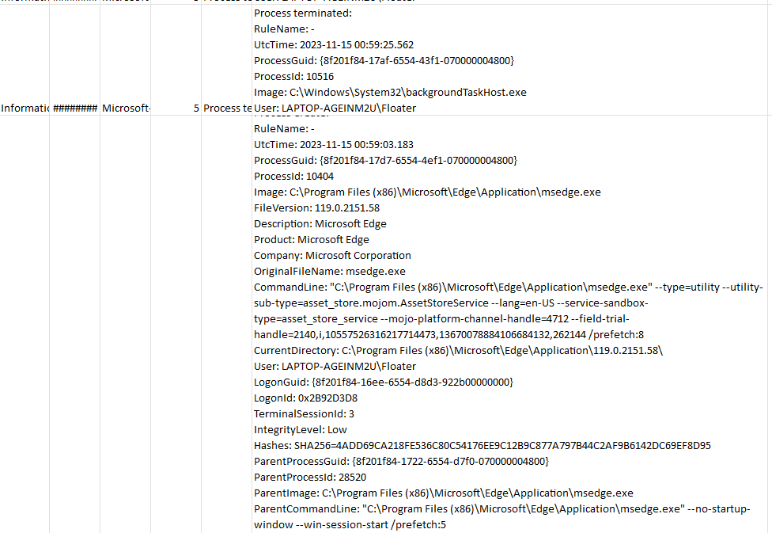
Data Collection and Preprocessing
Sysmon installed onto OS collects data for 1 week
CSV VERY untidy
Encode common strings to numbers
Tree built to mimic file system from log info

Slide 4

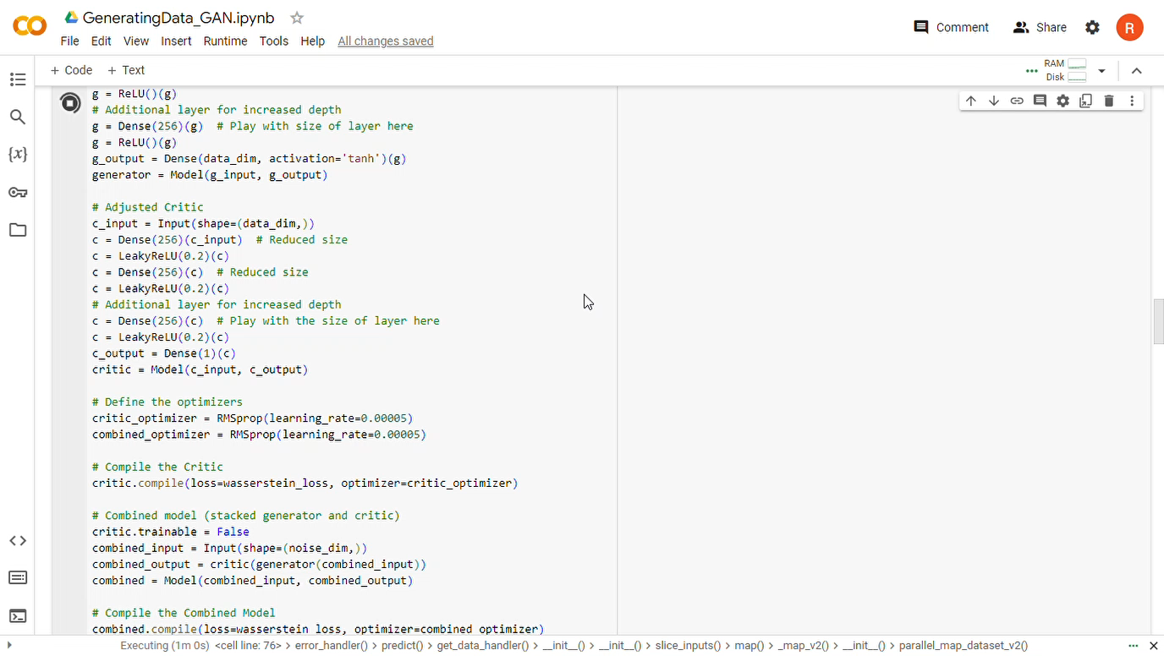
Generative Adversarial Network (GAN) Modeling
Generator trained to create fake data
Critic (discriminator) trained to detect fake data
Both models improve over time from performance metrics
This Photo by Unknown author is licensed under CC BY.

Slide 5

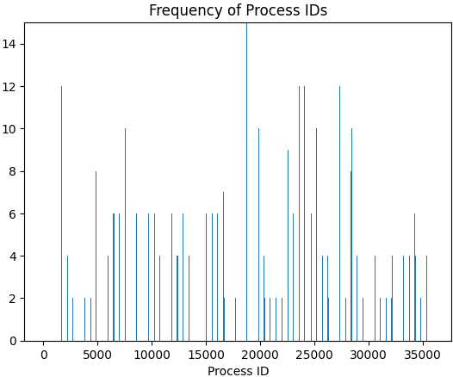
Exploratory Data Analysis
Findings showed images do not favor process IDs
OS does favor specific process IDs
Most executables launched from exe directory
System executables more random

